Slide 1
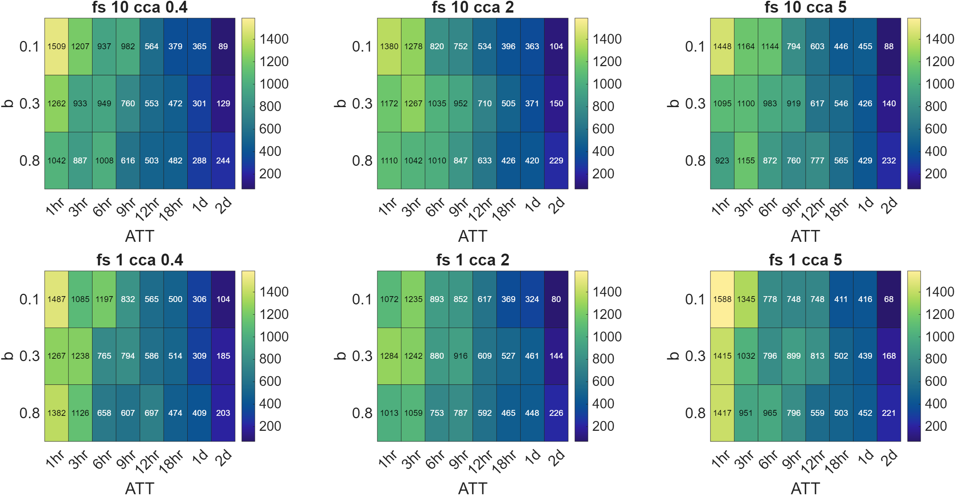
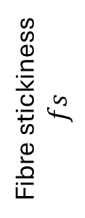
Total activated cells at day 5
Cca cell-cell adhesion
Fibre stickiness
$$fs$$

Slide 2
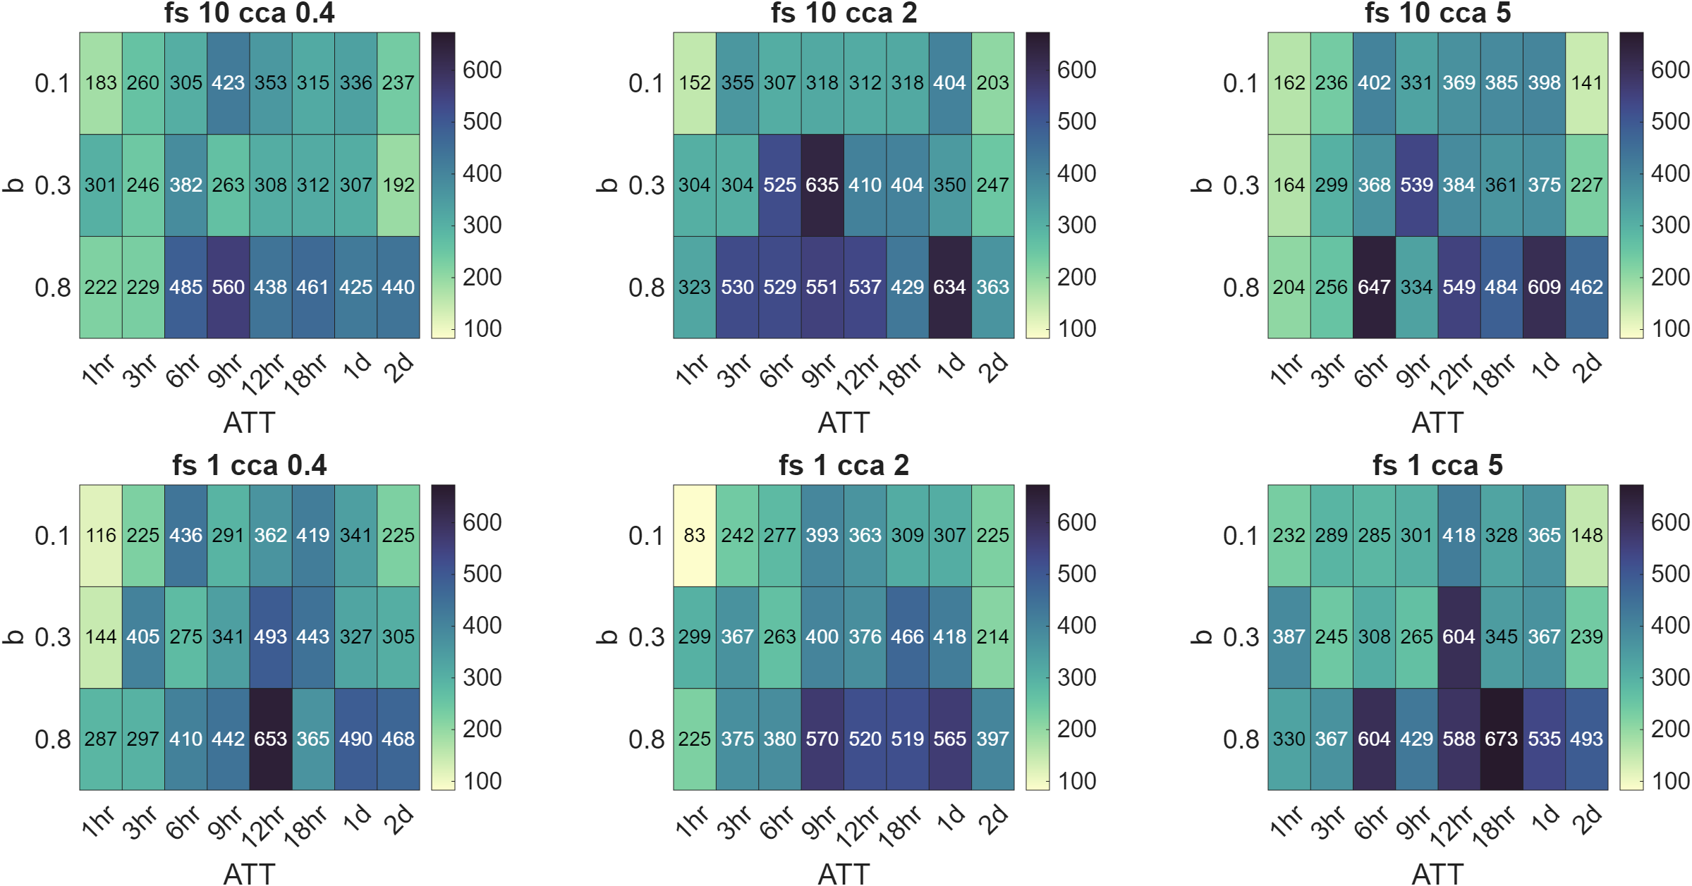
Total naïve cells at day 5
Cca cell-cell adhesion
Fibre stickiness
$$fs$$

Slide 3
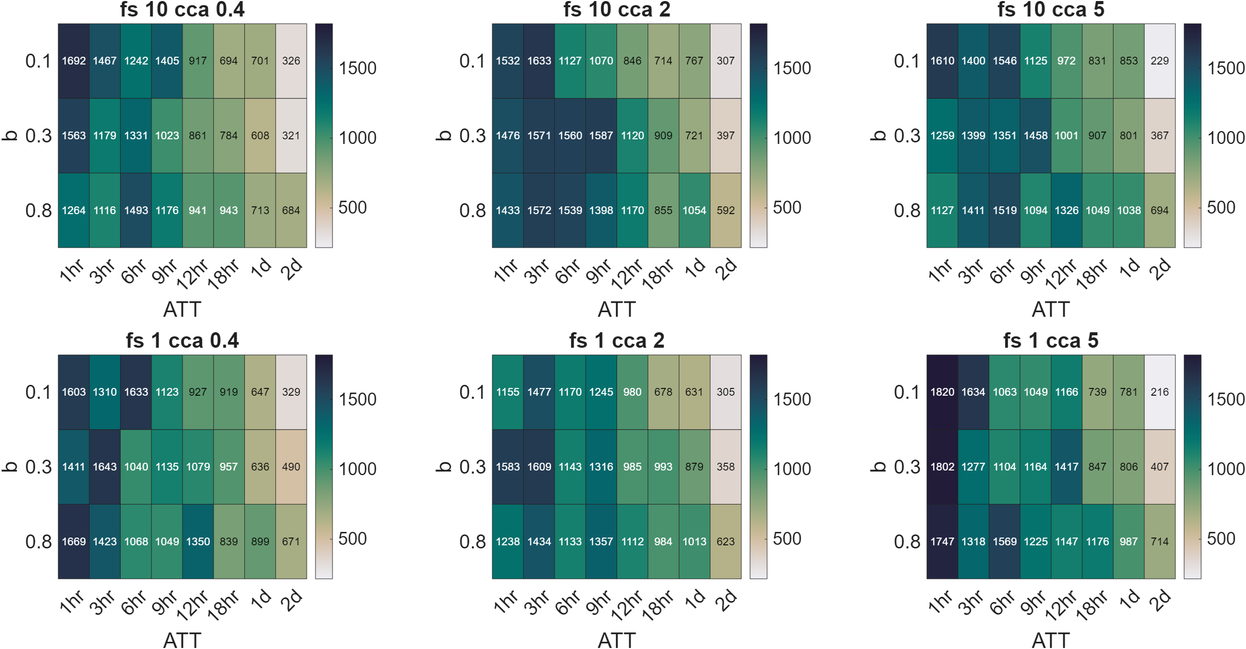
Total cells at day 5
Cca cell-cell adhesion
Fibre stickiness
$$fs$$

Slide 4
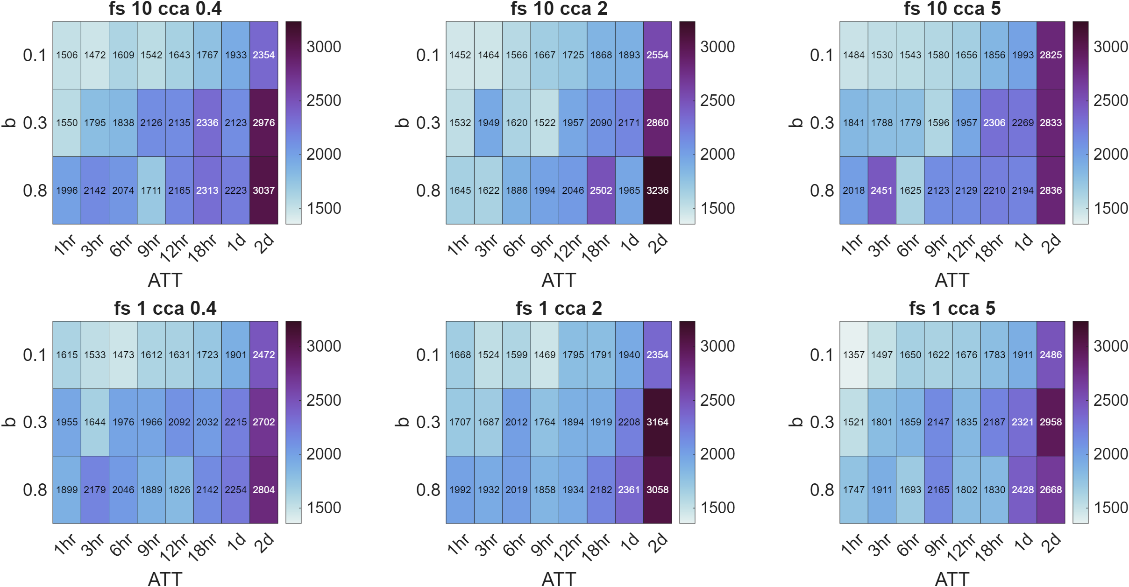
Mean cell-rod contact time at day 5
Cca cell-cell adhesion
Fibre stickiness
$$fs$$

Slide 5
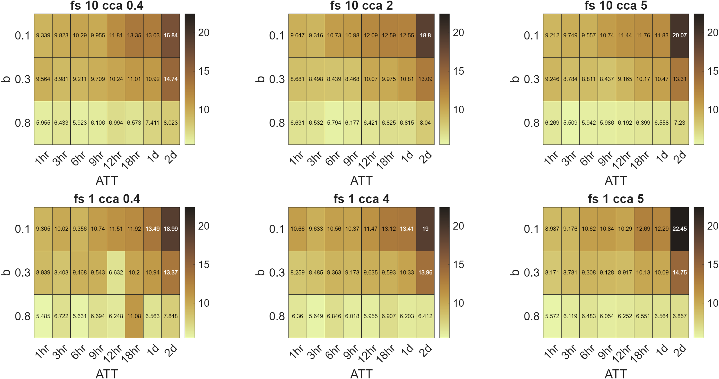
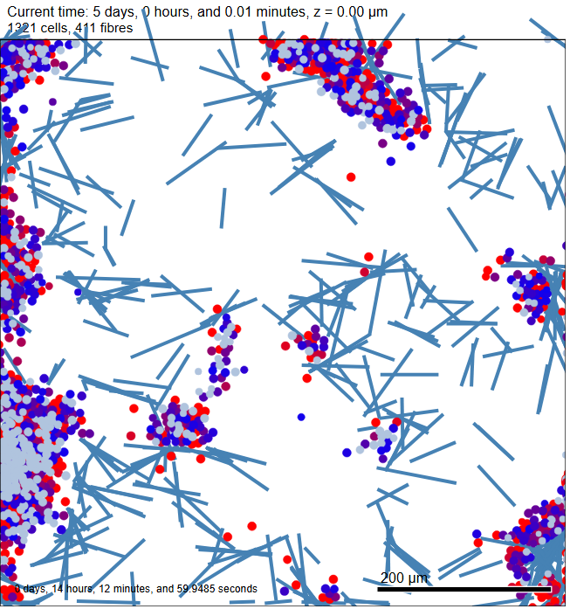
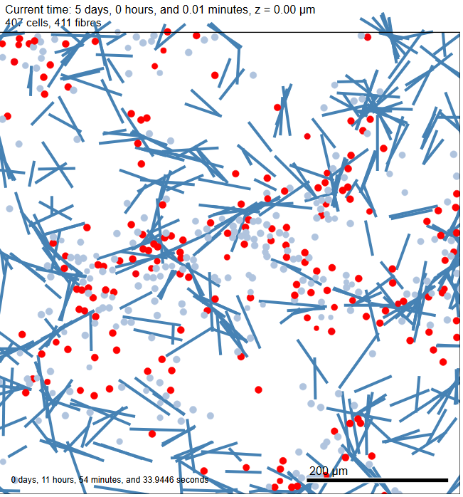
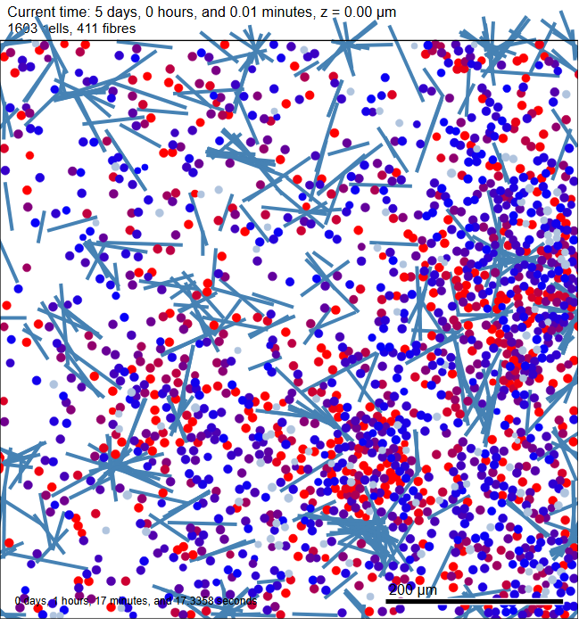
Average minimum T cell-T cell dist
Cca cell-cell adhesion
Fibre stickiness
$$fs$$

Slide 6
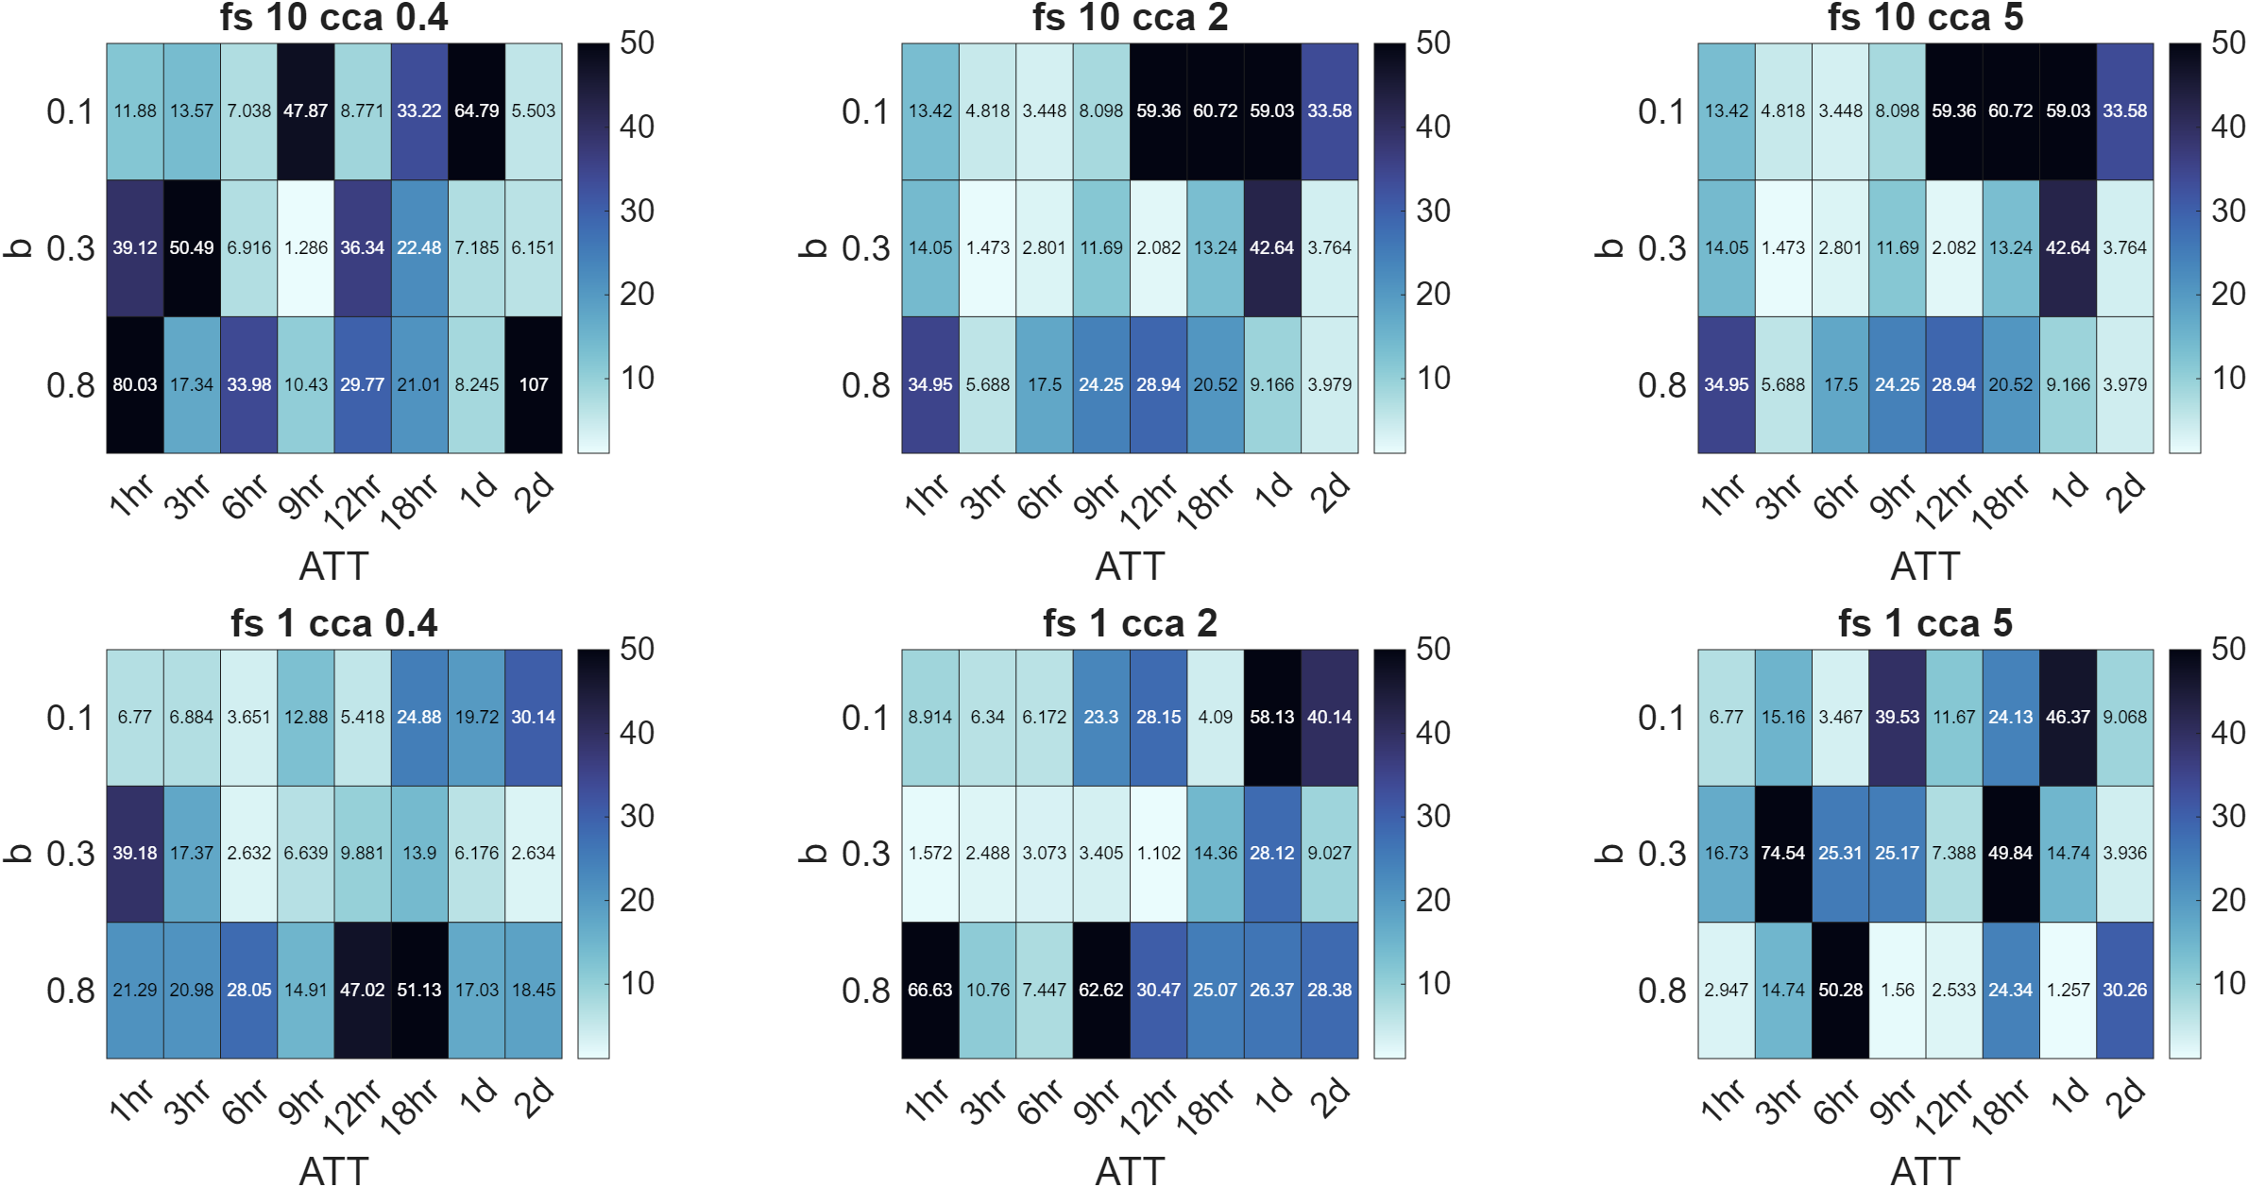
Average minimum rod-rod dist
Cca cell-cell adhesion
Fibre stickiness
$$fs$$

Slide 7
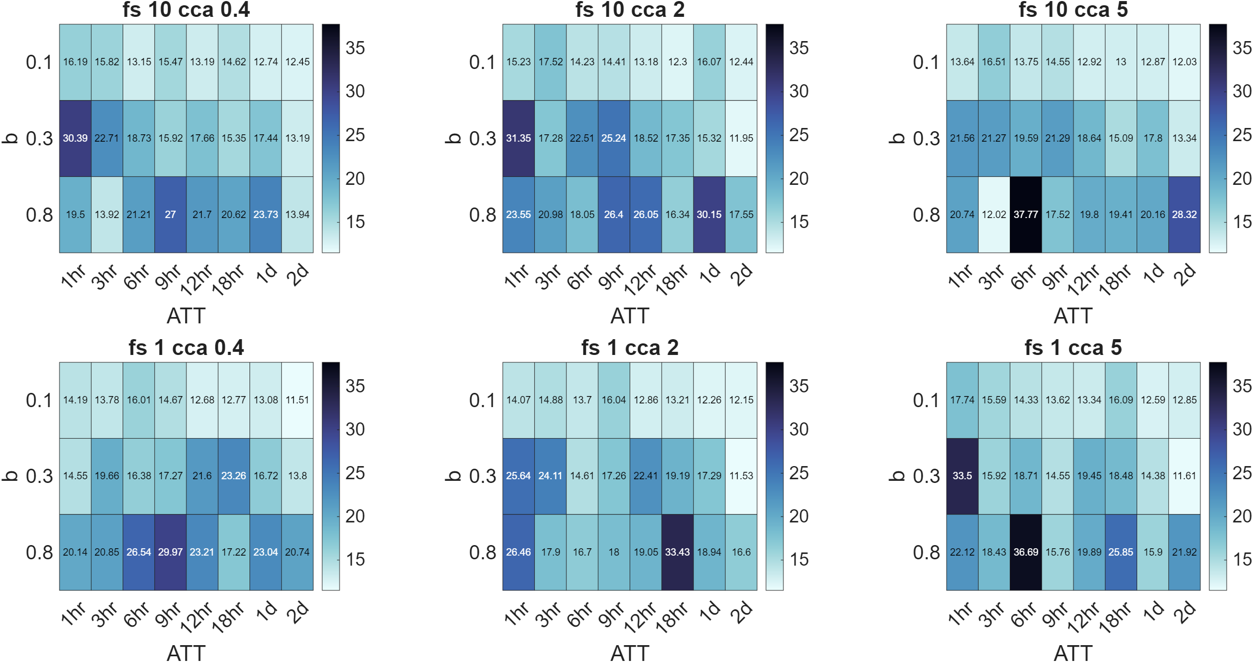
Average minimum cell-rod dist
Cca cell-cell adhesion
Fibre stickiness
$$fs$$

Slide 8
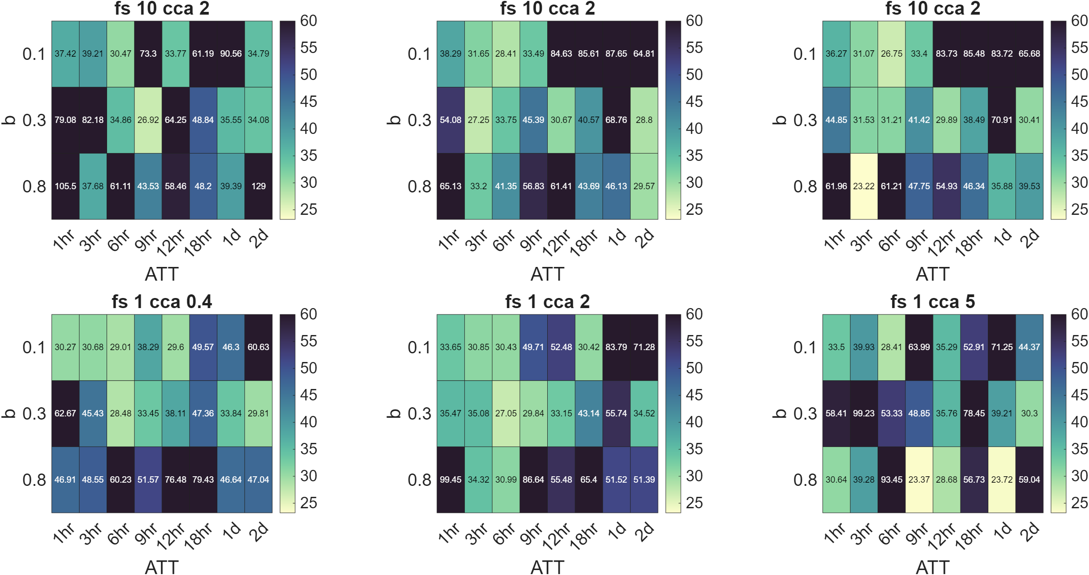
Sum of average cell-cell, rod-rod, cell-rod minimum dist
Cca cell-cell adhesion
Fibre stickiness
$$fs$$

